Slide 1
Logistic Regression

Slide 2
Logistic Regression in R Programming
Logistic regression in R Programming is a classification algorithm used to find the probability of event success and event failure. Logistic regression is used when the dependent variable is binary(0/1, True/False, Yes/No) in nature. The logit function is used as a link function in a binomial distribution.
A binary outcome variable’s probability can be predicted using the statistical modeling technique known as logistic regression. It is widely employed in many different industries, including marketing, finance, social sciences, and medical research.

Slide 3
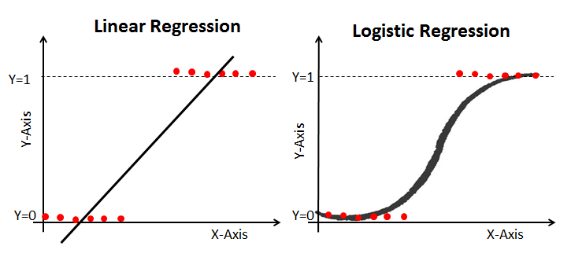
The logistic function, commonly referred to as the sigmoid function, is the basic idea underpinning logistic regression. This sigmoid function is used in logistic regression to describe the correlation between the predictor variables and the likelihood of the binary outcome.

Slide 4
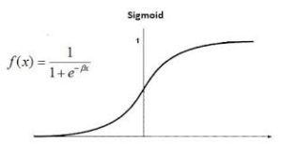

Slide 5

Logistics regression is also known as a generalized linear model. As it is used as a classification technique to predict a qualitative response, the Value of y ranges from 0 to 1 and can be represented by the following equation:

Slide 6

p is the probability of characteristic of interest. The odds ratio is defined as the probability of success in comparison to the probability of failure. It is a key representation of logistic regression coefficients and can take values between 0 and infinity. The odds ratio of 1 is when the probability of success is equal to the probability of failure. The odds ratio of 2 is when the probability of success is twice the probability of failure. The odds ratio of 0.5 is when the probability of failure is twice the probability of success.

Slide 7
Since we are working with a binomial distribution(dependent variable), we need to choose a link function that is best suited for this distribution.

Slide 8
Example
Calculate the probability of pass for the student who studded 33 hours
Study_Hours | Pass/ Fail
29 | 0
15 | 0
33 | 1
28 | 1
39 | 1

Slide 9
Calculate the probability of pass for the student who studded 33 hours
At least how many hours student should study to that make he will pass the course with the probability of 95%. Also draw the graph of Logistic regression

Slide 10
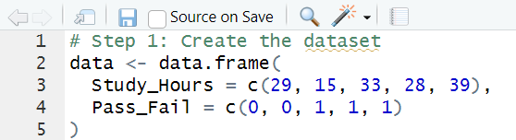
Code

Slide 11
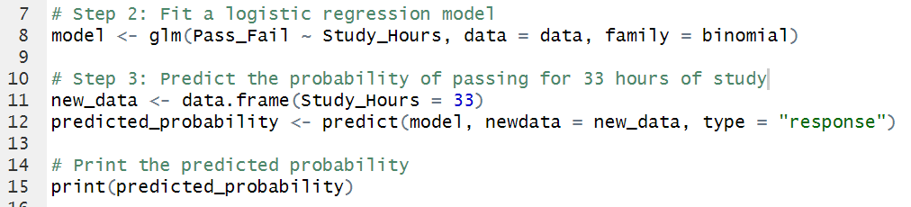

Slide 12
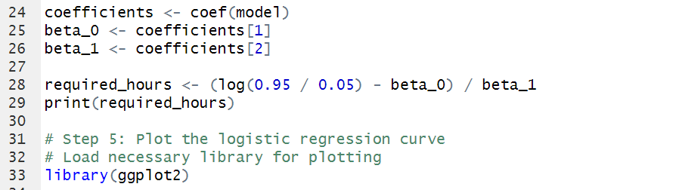

Slide 13
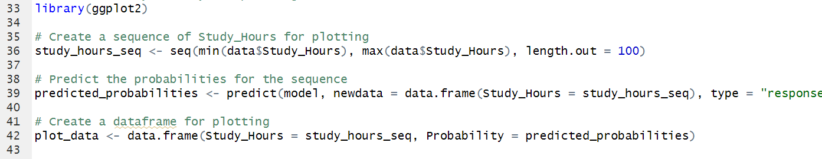

Slide 14
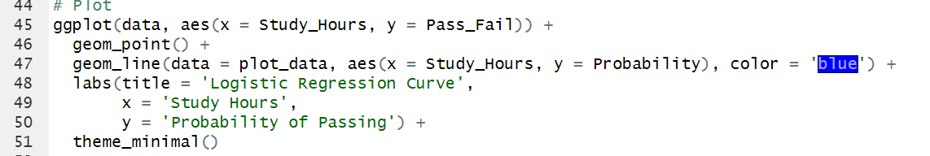

Slide 15

Answer: Question 01

Slide 16
Answer: Question 02

Slide 17
